Slide 1
Topology Formation

Slide 2
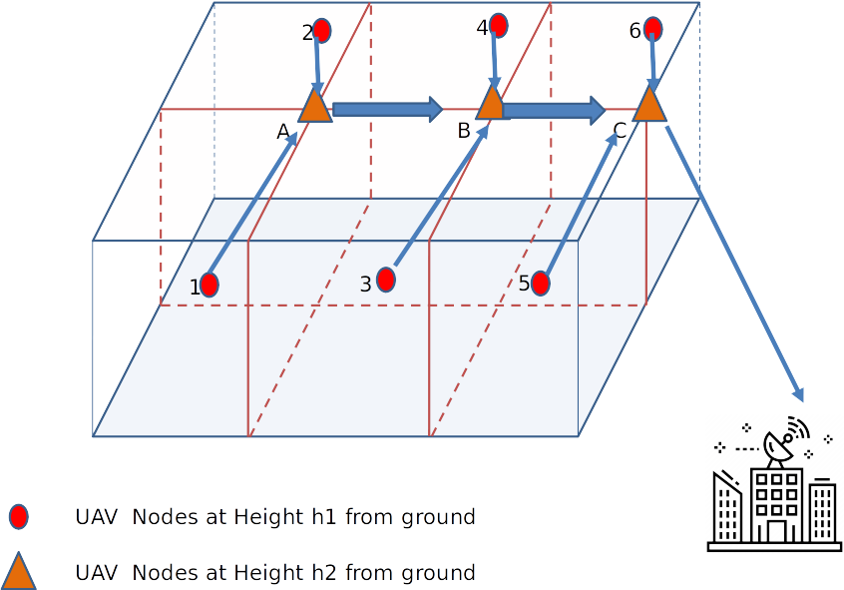
Topology
Static formation
Nodes on left and right can be more than 1
Additional chain of nodes towards base station

Slide 3

Formation algorithm
Area to cover
Base station

Slide 4
Formation algorithm
Child
Parent
Child
Parent
Rc
Rc
Control command
Notes:
Drones fly in chain formation. Leader commanded to go towards the target (triangle). Each drone commands its child to move relative to itself.
Each node is the parent of the node after it and is the child of the node before it.
Till the leader reaches the target -> chain formation

Slide 5
Formation algorithm
No. of neighbors = 1:
Command: left

Slide 6
Formation algorithm
Going left:
Change parent to Node 0
Move ahead

Slide 7
Formation algorithm
No. of neighbors = 2:
Command: right

Slide 8
Formation algorithm

Slide 9
Formation algorithm
Going right:
Change parent to Node 0
Move ahead

Slide 10
Formation algorithm
No. of neighbors = 3:
Command: stay there, take command

Slide 11
Formation algorithm

Slide 12
Formation algorithm
No. of neighbors = 1:
Command: left
Repeat

Slide 13
Formation algorithm
No. of neighbors = 3,
Area covered:
Command: stay there, form chain
Formation Complete

Slide 14
Message Structure
my_id (int): Id of the sender node: 0.5B
recp_id (int): Recipient ID: 0.5B
Status (int): New status of child (left, left_exp, left_static, right, right_exp, right_static, center etc.): 0.5B
my_pos (float32 [3]): x, y, z coordinates of sender node: 3x2B = 6B
des_pos (float32 [3]): x, y, z coordinates to which the child should go: 3x2B = 6B
new_parent (int): This is the parent id to which the child should listen from now: 0.5B
Notes:
Status will be none by default for all except leader. The parent commands the next state of the child

Slide 15
Message Structure
8 bit
8 bit
My_id + recp_id
Status + new_parent_id
float16
X
Y
my_pos
Z
X
Y
des_pos
Z

Slide 16
Message Structure
8 bit
8 bit
My_id + recp_id
Status + new_parent_id
float16
X
Y
my_pos
Z
X
Y
des_pos
Z

Slide 17
Sample message structure: Chain
Node 0 (Leader) -> Node 1
{
0
1
[Xp, Yp, Zp]
[Xp - Rc, Yp, Zp]
0
}

Slide 18
Sample message structure: Go left
Node 0 (Leader) -> Node 1
{
0
1
[Xp, Yp, Zp]
[Xp, Yp - Dc, Zp + Dz] # (Dc^2 + Dz^2 = Rc^2)
0
}

Slide 19
Sample message structure: Change parent
Node 1 -> Node 2
{
1
2
[Xp, Yp, Zp]
[Xp, Yp, Zp]
0 # Note: the parent has changed from 1 to 0 so next time Node 2 will listen to Node 0 and not Node 1
}

